Slide 1

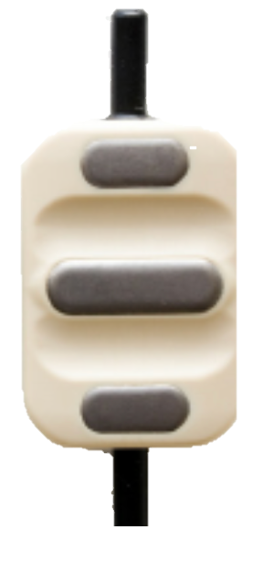
EMG DESC Electrodes
Graphical Programming Exam Project

Slide 2
Summary
General Characteristics
Aim of the Project
Work Pipeline
0. Load of the Data + Selection of the Mode (Raw/Env)
High Pass Filtering
Full Wave Rectification
Low Pass Filtering
Normalisation
Thresholding
Results

Slide 3


General Characteristics
Surface EMG
Amplifier
Anti-Aliasing FIlter
ADC
4. Norma-isation
3. Smoothing
2.
Full-wave Rectifier
1. Filtering
Acquire EMG Signals in 2 Different Modalities
Raw Data (without any preprocessing)
Enveloped (Filtered and Rectified)
Produce a Feedback stimulation through a Motor
5. Thresholding
Processing Pipeline
Processed EMG
Feedback Sensation
Artefacts

Slide 4
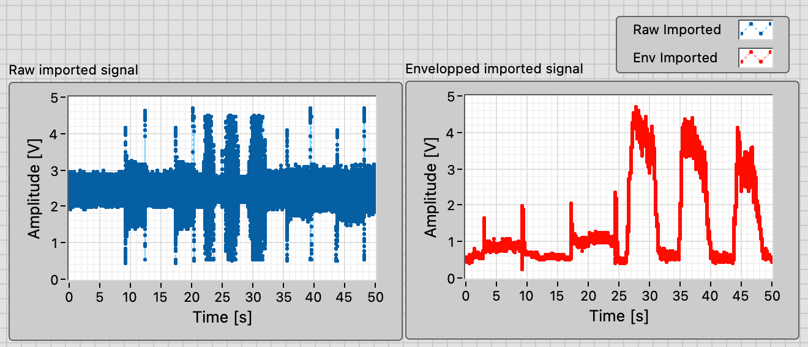
Aim of the Project
Motor Noise
Useful EMG
Create a Labview pipeline for the offline automatic process of DESC electrodes EMG Data
Compare the results of a simple threshold segmentation to extract the useful EMG (from Environmental and Motor Noises)
Environmental Noise

Slide 5
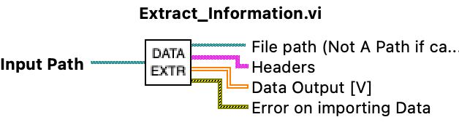
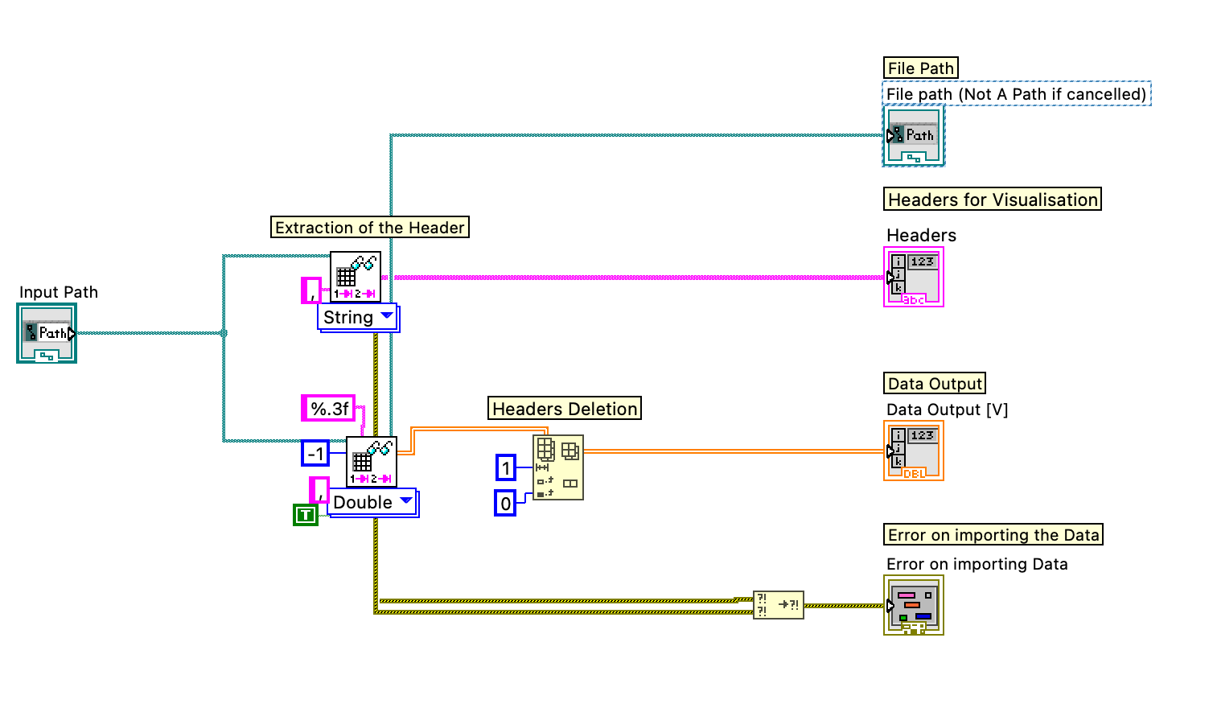
0. Load of the Data

Slide 6
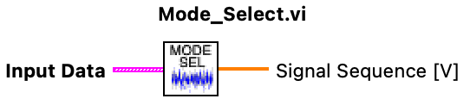
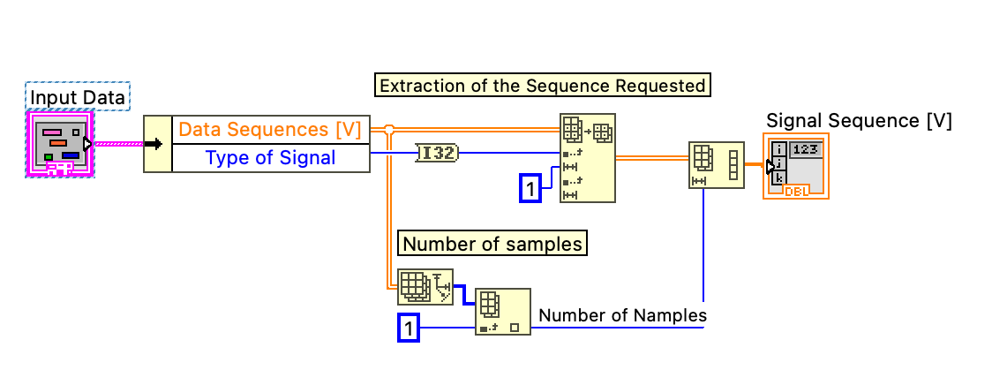
0. Selection of the Mode

Slide 7
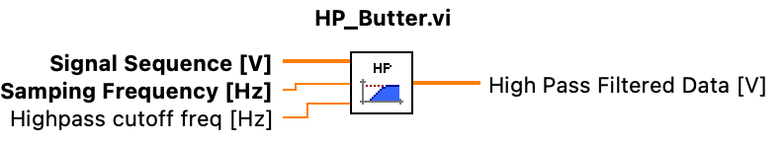
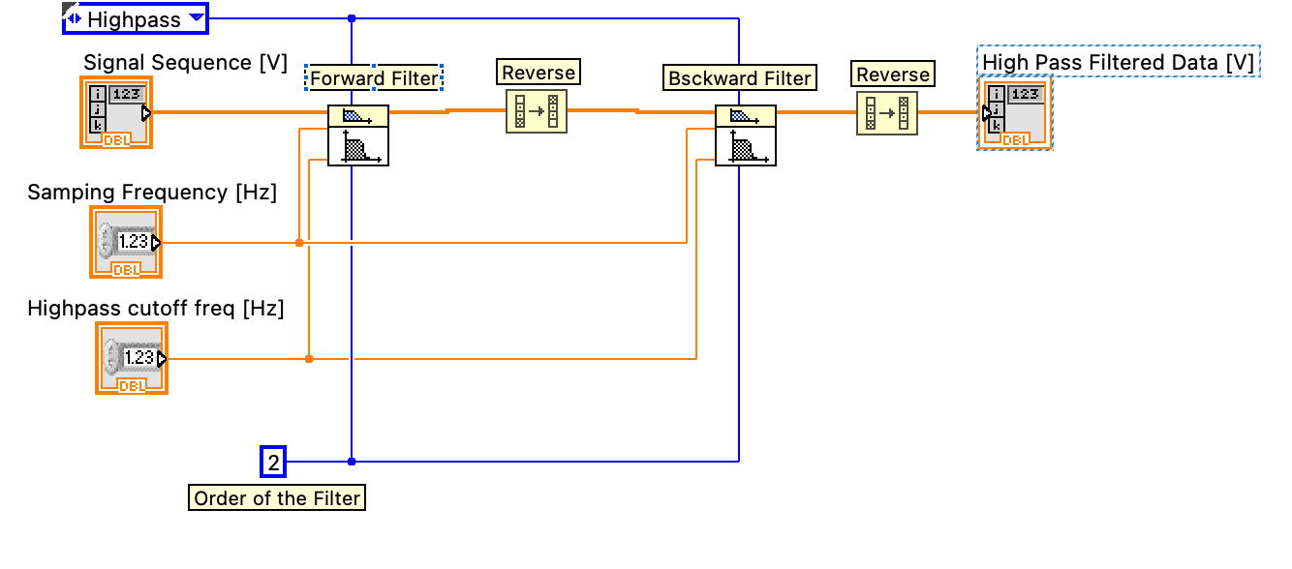
1. High Pass Filtering
2nd Order, zero phase, HP, Butterworth Filter

Slide 8
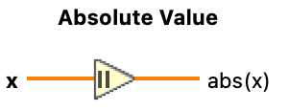
2. Full Wave Rectification
Vout = |Vin|

Slide 9
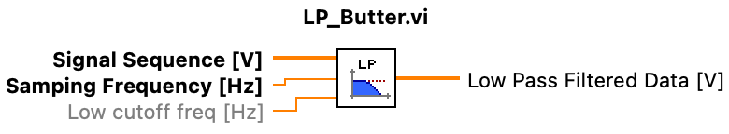
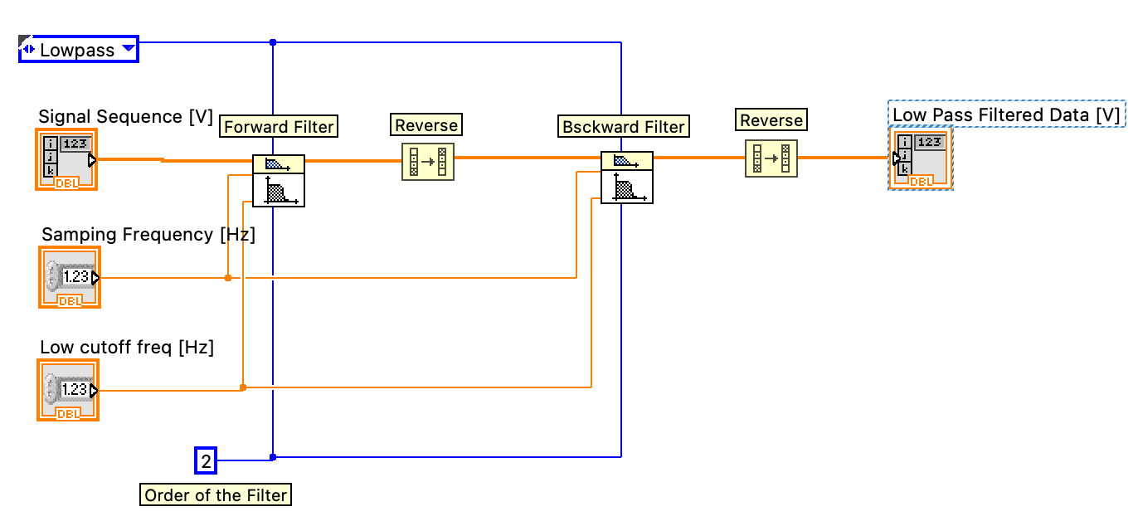
3. Low Pass Filtering
2nd Order, zero phase, LP, Butterworth Filter

Slide 10
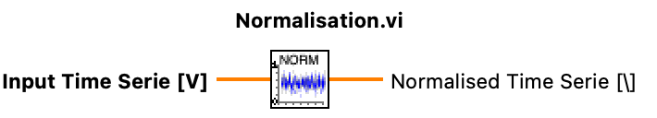
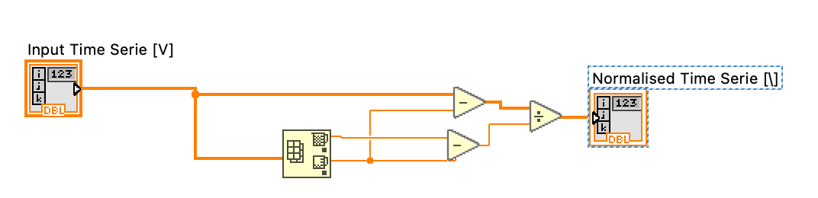
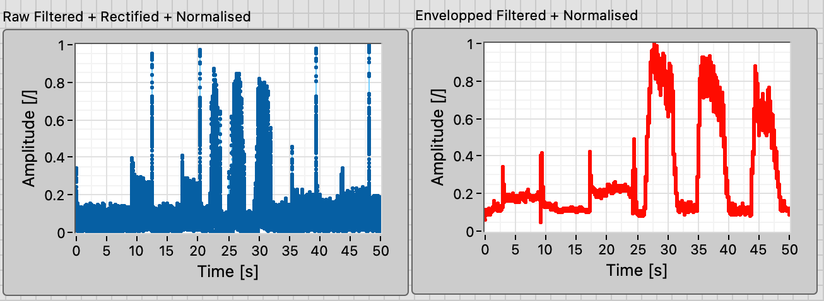
4. Normalisation
Vout(k) = (Vin(k) – Vmin) / (Vmax - Vmin)

Slide 11

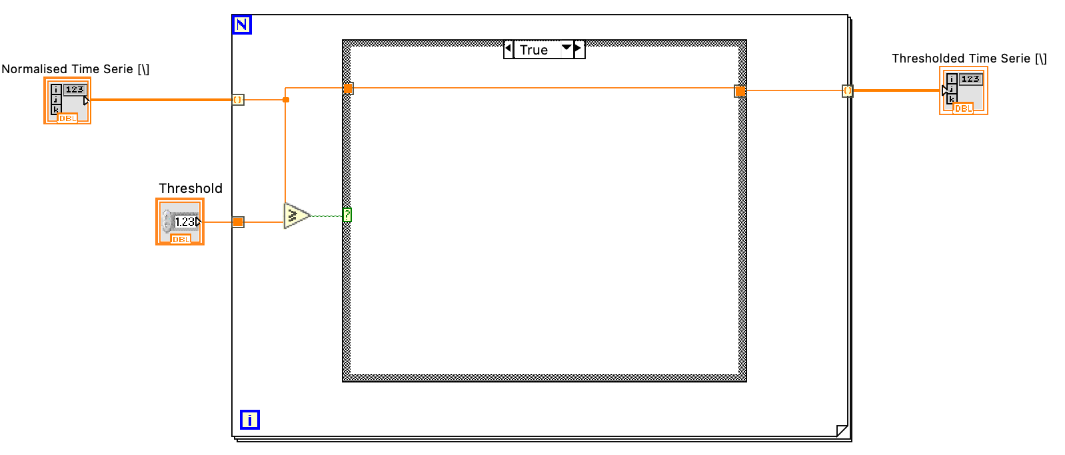
5. Thresholding

Slide 12
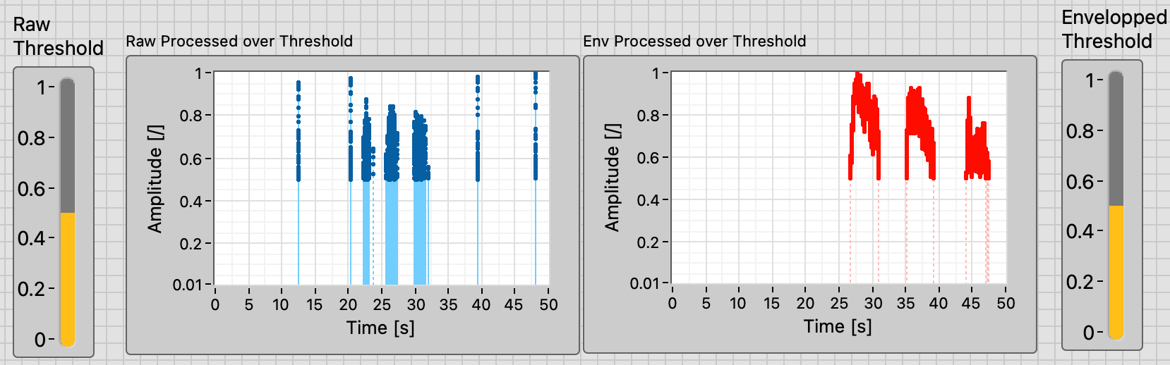
Results
With the thresholding, the enveloped signal was correctly segmented.
While some motor artefacts were too prominent in the Raw signal to be filtered out.

